Slide 2
LM Randomly Good | Recap
Last Session…

Slide 3
LM Randomly Good | Learning Objectives
At the end of this unit you should be able to:
prepare your data for machine learning,
understand the basic concept of random forest,
train a random forest model with random cross-validation,
determine the suitability of random cross-validation as a validation strategy for spatial data.

Slide 4

LM Randomly Good | Random Forest
Image: Venkata Jagannath [CC BY-SA 4.0] via wikimedia.org
Notes:
https://en.wikipedia.org/wiki/Random_forest#/media/File:Random_forest_diagram_complete.png

Slide 5
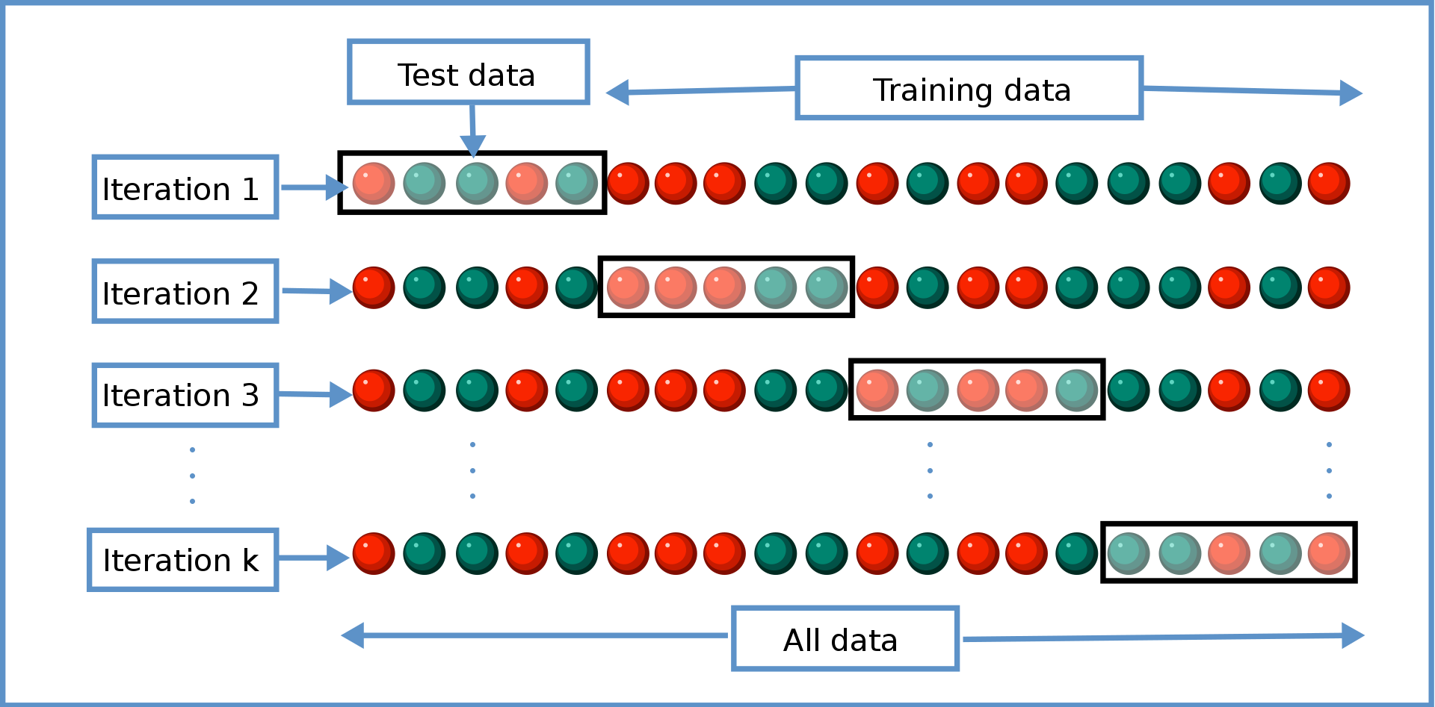
LM Randomly Good | Cross-Validation
Image: Gufosowa [CC BY-SA 4.0] via wikimedia.org
Notes:
https://en.wikipedia.org/wiki/Cross-validation_(statistics)#/media/File:K-fold_cross_validation_EN.svg

Slide 6
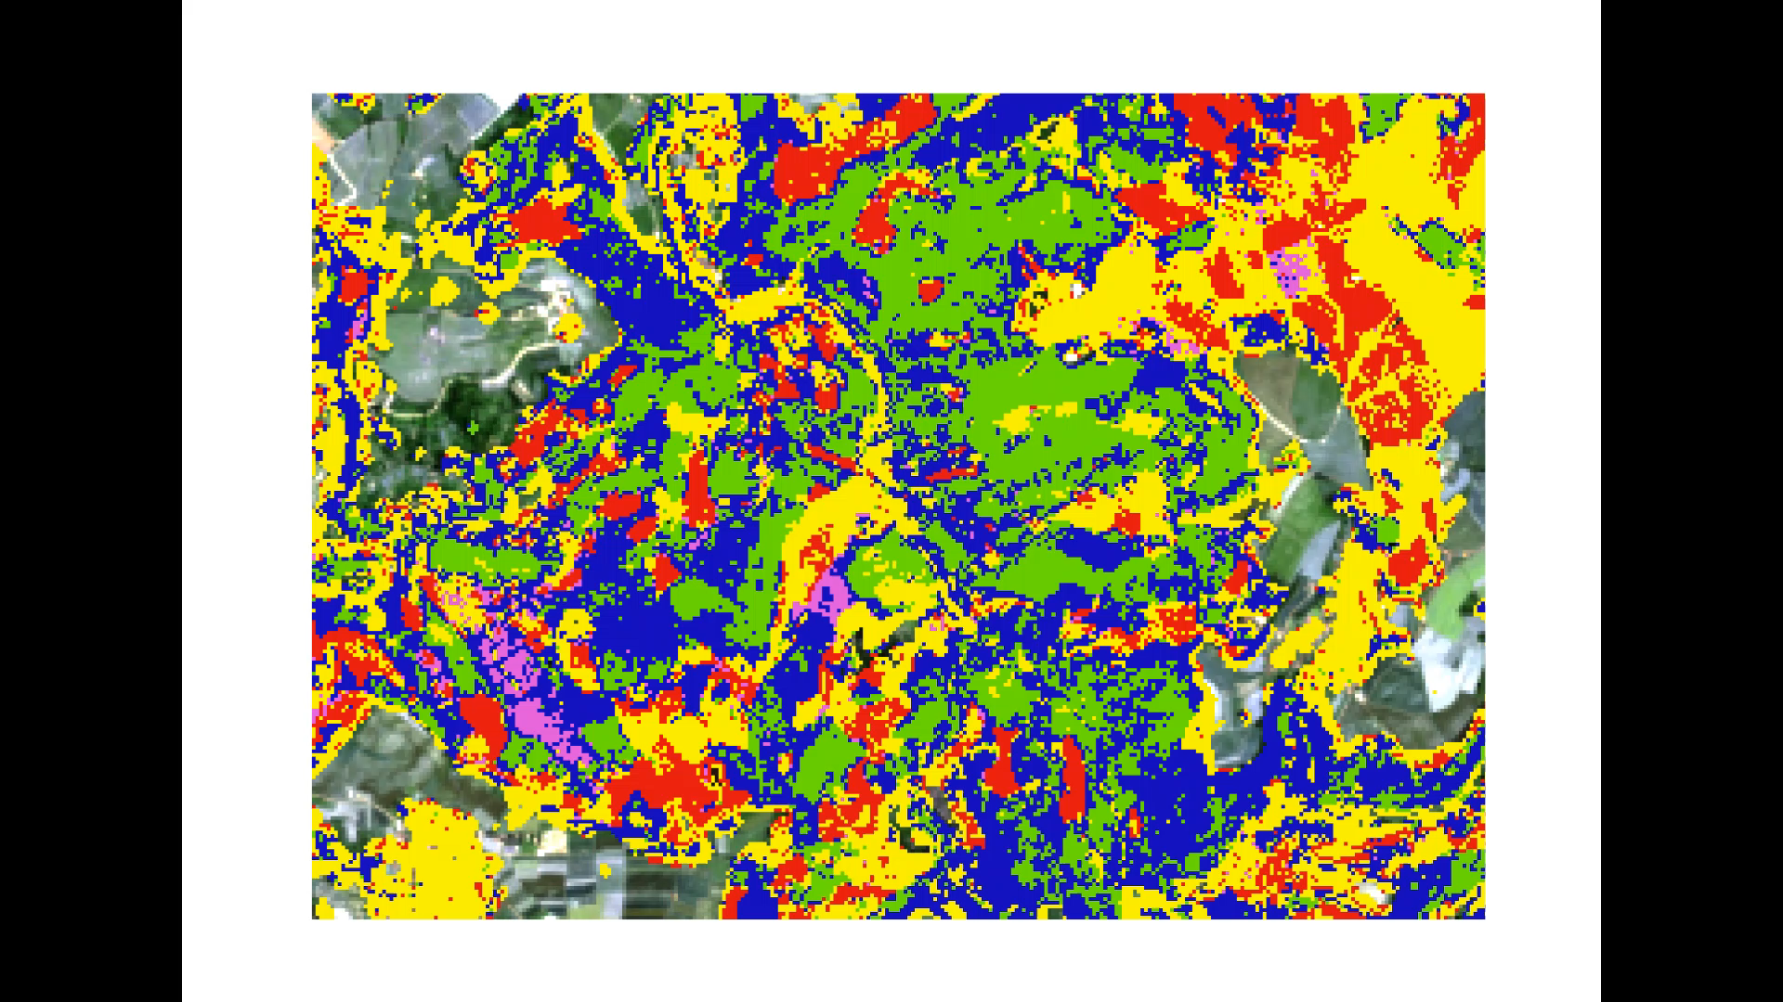
LM Randomly Good | Prediction or coincidence?

Slide 7
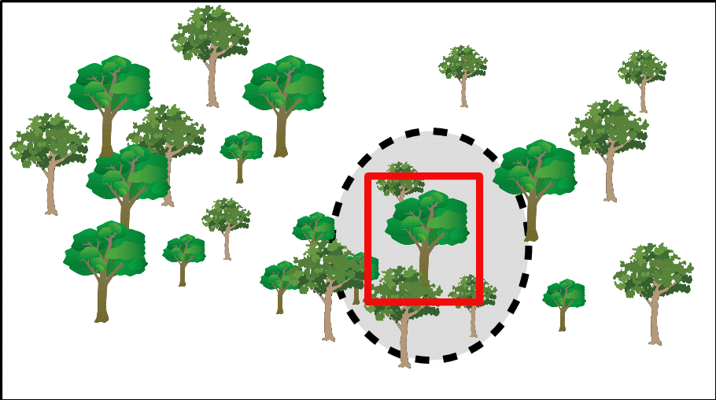
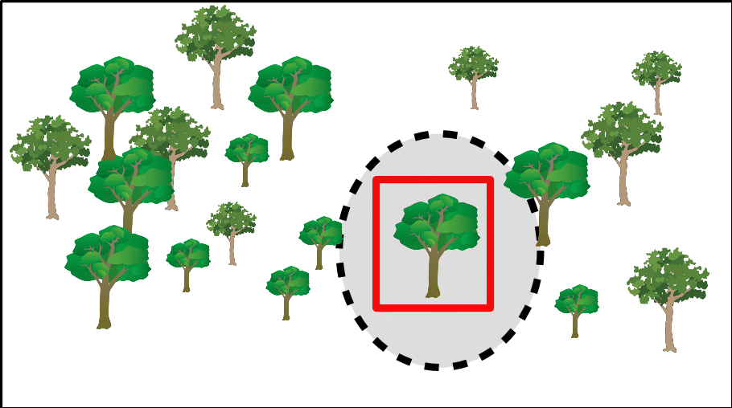
LM Randomly Good | Spatiality
Symbols: ian.umces.edu/media-library/ [CC BY-SA 4.0]

